Slide 1

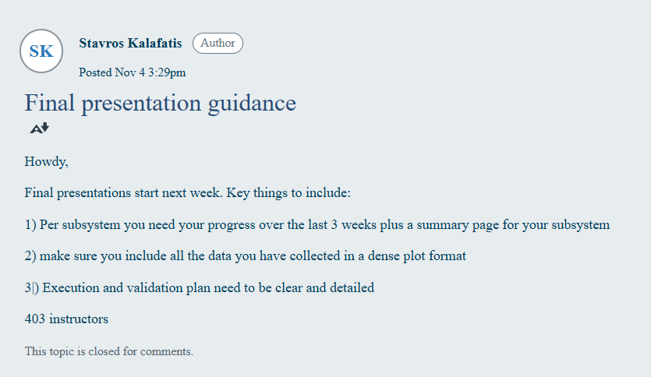

ECEN 403
Final Presentation
Team #25: The Only WGT Team Lead: Serene Singh
Joe Knipper, Salina Teng, Brayden Donovan
TA: Jianhan Pan
Sponsor: John Lusher

Slide 2
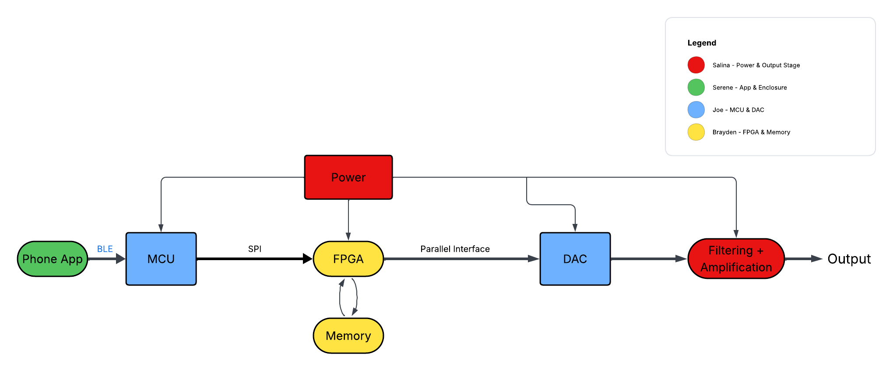
System Overview
Notes:
Cloud server and databaseThis figure should clearly show what HW & SW are being developed / integrated into each subsystem. Some interconnected boxes showing how subsystems will be connected for system.
Owner should be clear … name and color code
Interfaces – arrows between boxes, where known should be labeled…Bluetooth, I2C, Websocket
Push notifications, USB, LORA, …
NOT TOO MUCH DETAIL!

Slide 3
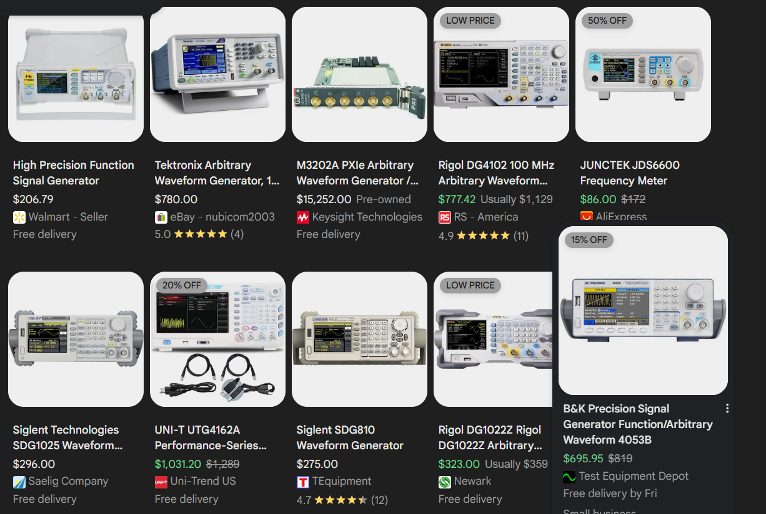
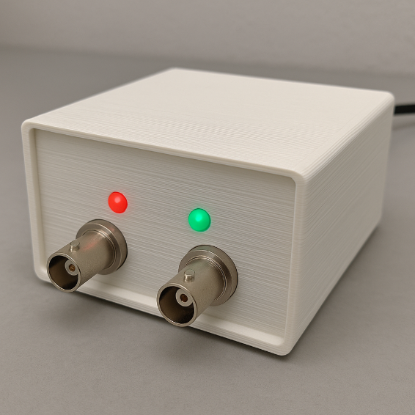
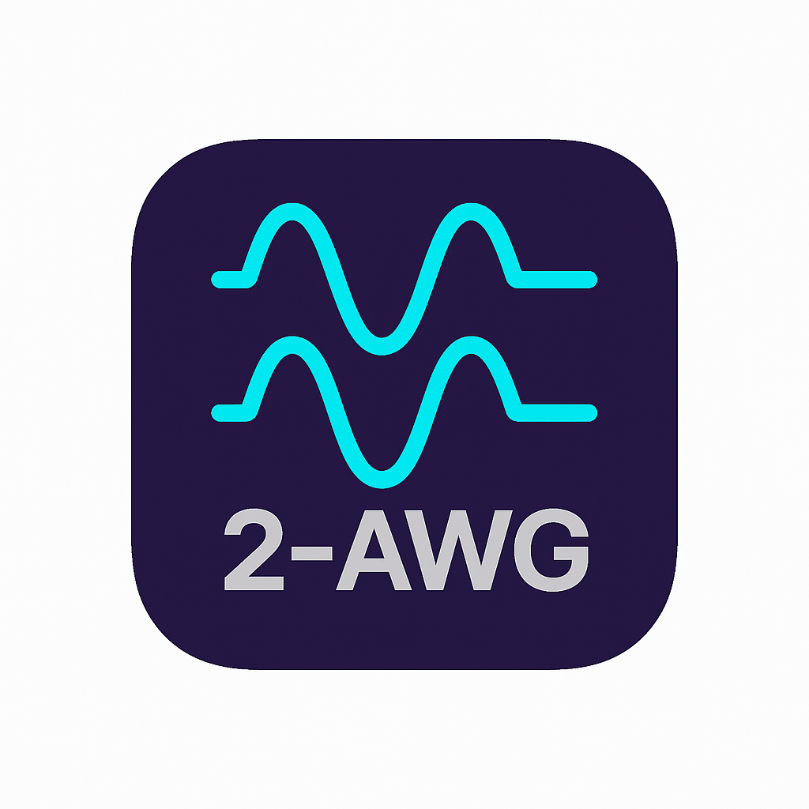
Project Summary
Problem Statement:
Traditional AWGs are bulky, confusing, and expensive
Average Price Range $200 to <$1000
Our Solution:
Compact, dual-channel Arbitrary Waveform Generator (AWG)
Controlled via mobile app with user-friendly UI
Outputs both standard (sine, square, triangle) and custom user-defined signals
Notes:
Good ENGINEERING figure here…eg plot showing the trend of the problem getting worse, figure showing a failed product, good logo for your product, …

Slide 4
Mobile Subsystem
Serene Singh
Design
Test
Validate
Design a user friendly cross-platform app for AWG
Successfully Test BLE connection stability and packet transfer
Quantitatively verify successful tests
Established BLE Connection with MCU
Developed Front-End UI
Preset, Drawable, and Arbitrary adjustable screens with local waveform simulation
Included waveform editing, uploading, and downloading
Verified standard waveform parameters send to MCU accurately
Verified arbitrary waveform packets send to MCU accurately
Stress and Repeatability Testing ensured consistent results
App → MCU Communication connection strong and consistent within operational range
Ability to send numeric values, preset parameters, and Arbitrary waveform packages
Logging and Response confirmation from MSU
Notes:
Overview of what has been designed, tested, and validated for each subsystem for the project. (this is NOT a progress update, but rather a summary of what you have accomplished in 403).

Slide 5
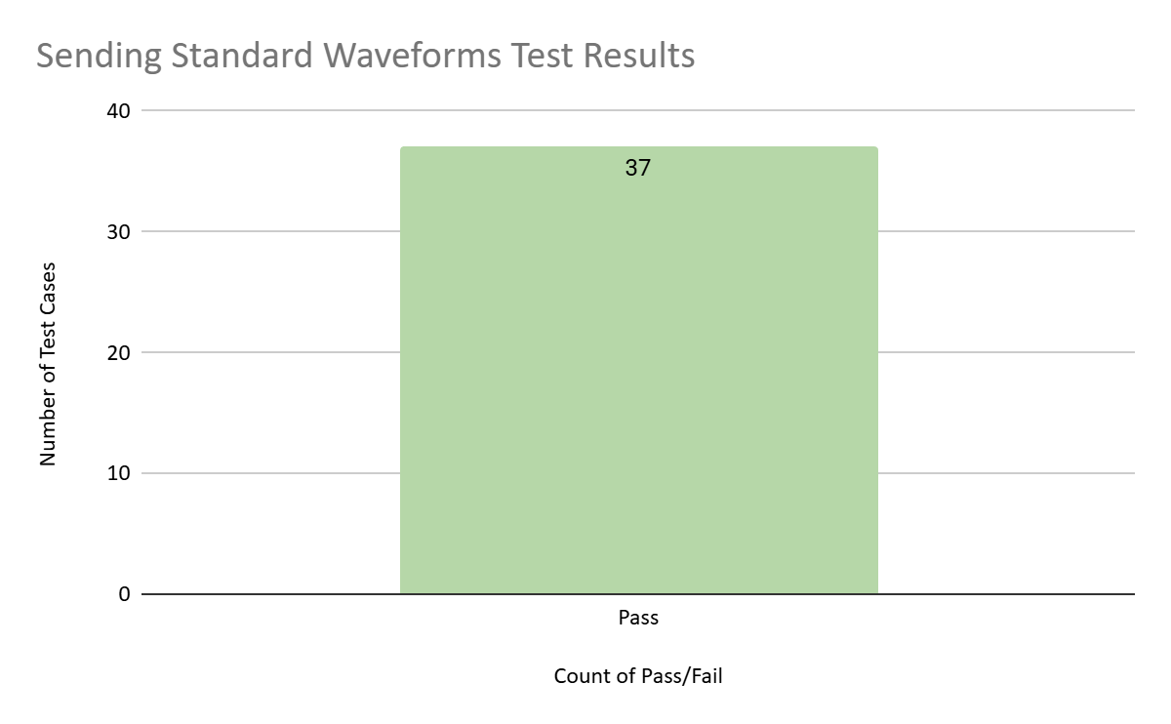
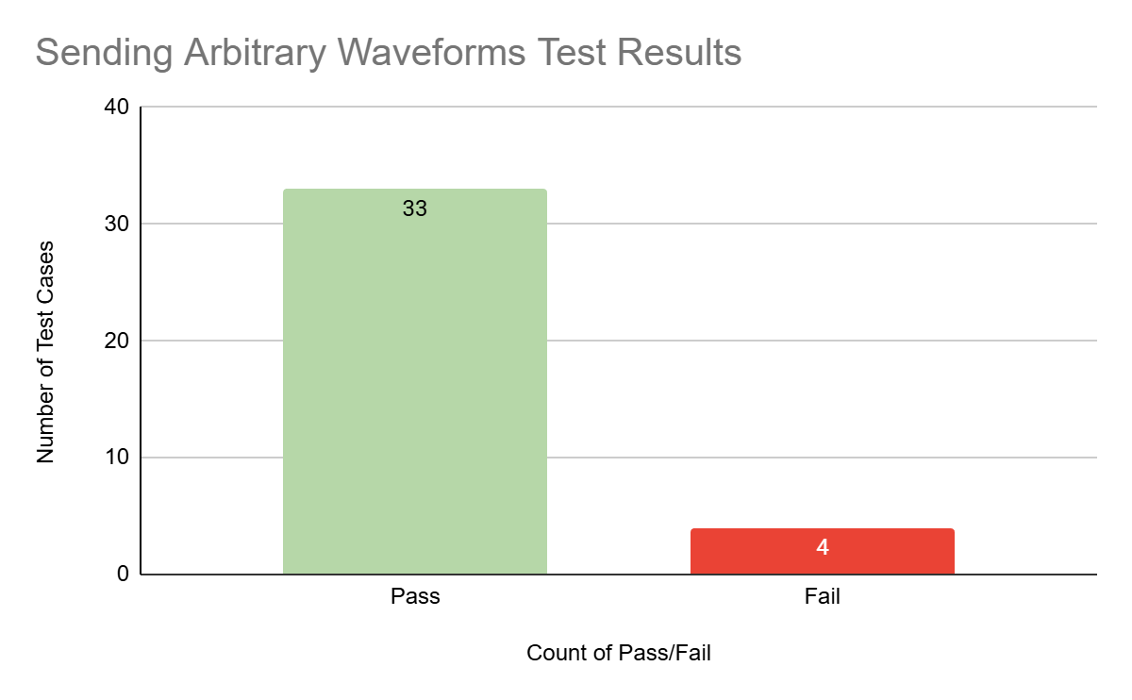
Verifying Standard/Arbitrary Parameters
All Tests Passed! 44/44
Some Tests Failed! 34/38
User Input Boundaries Need to be Implemented
Notes:
Show data collected and measured and/or simulated results (2 slides per subsystem)
Try to avoid screens of code
Save demo material for your project demo (video captures, storyboards, bench test pictures, etc.)

Slide 6
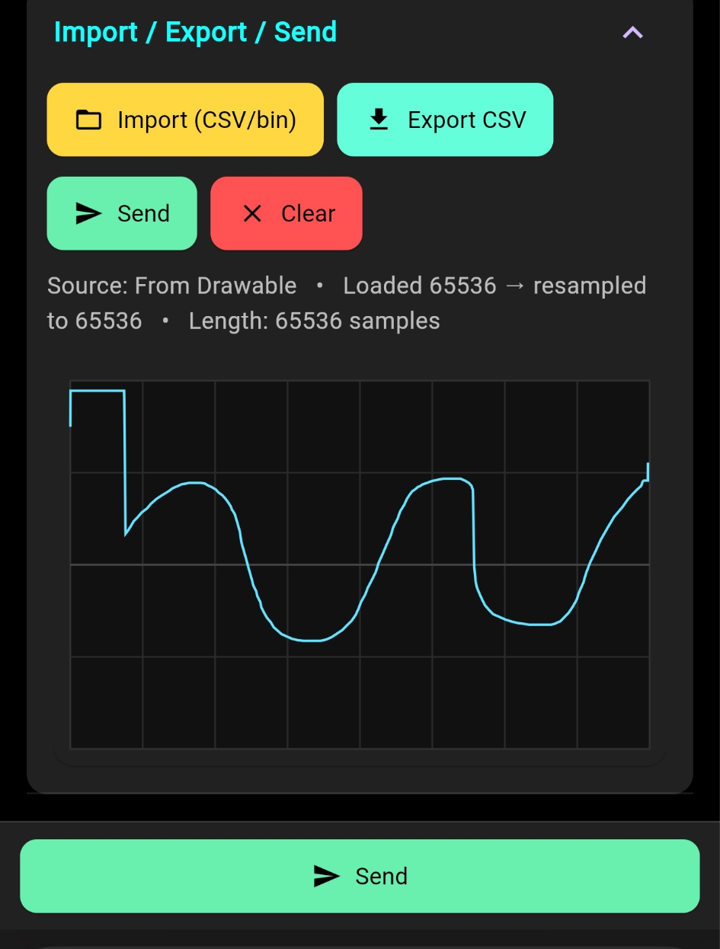
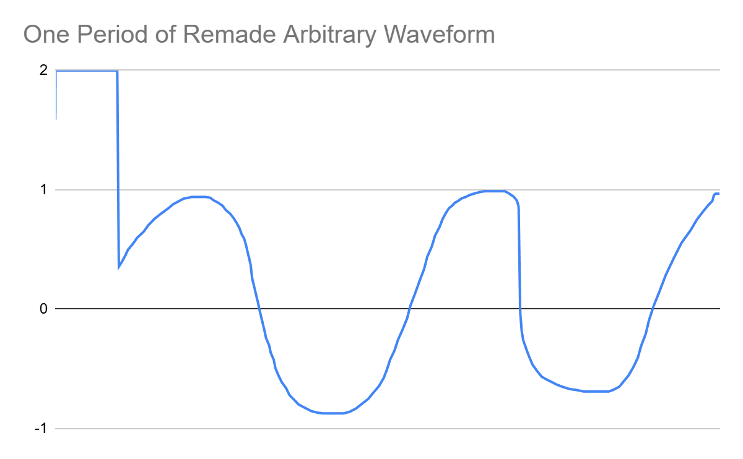
Arbitrary Waveform Rebuilt
[ARB DONE] LUT ready. cap=32768 f=1000.000 Hz, Vpp=2.000 V, offset=0.000 V, phase=0.000 deg, ch=A | min=-14297 max=32766
Rebuilt Waveform from ESP32
User Drawn + Edited Waveform
Notes:
Show data collected and measured and/or simulated results (2 slides per subsystem)
Try to avoid screens of code
Save demo material for your project demo (video captures, storyboards, bench test pictures, etc.)

Slide 7
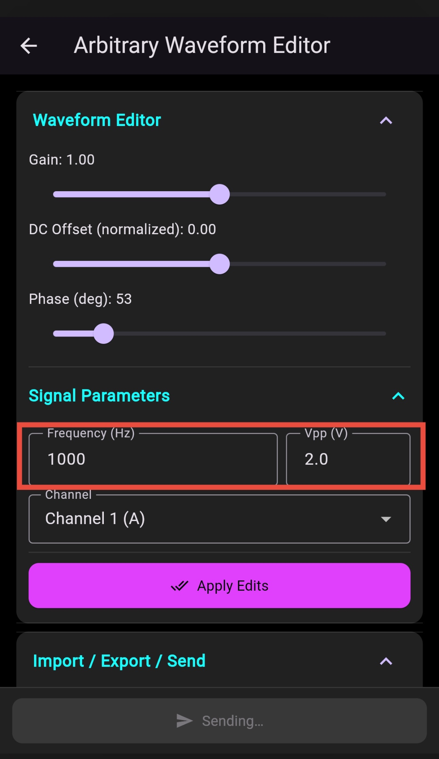
Remaining Tasks
Remaining in 403:
Add User Input Boundaries
To Complete in 404
Fully Integrate with MCU Subsystem
Finalize Enclosure
CAD Design
Print
Assemble

Slide 8
MCU Subsystem
Joe Knipper
Design
Test
Validate
Design a reliable embedded control subsystem for the AWG
Successfully Test BLE connection, LUT generation, and SPI stream
Quantitatively verify successful tests
Designed a custom ESP32-S3 MCU PCB
Implemented BLE firmware for receiving waveform parameters
Developed firmware to generate 64k-sample LUTs and stream them to the FPGA over SPI
Verified BLE connection is stable and robust
Verified 64k LUT generation is accurate
Verified SPI stream is accurate
MCU PCB BLE stable for 3+ hours
64K LUT waveform recreation 100% accurate
SPI stream validated using known parameters. 99.9% accurate
Notes:
Overview of what has been designed, tested, and validated for each subsystem for the project. (this is NOT a progress update, but rather a summary of what you have accomplished in 403).

Slide 9
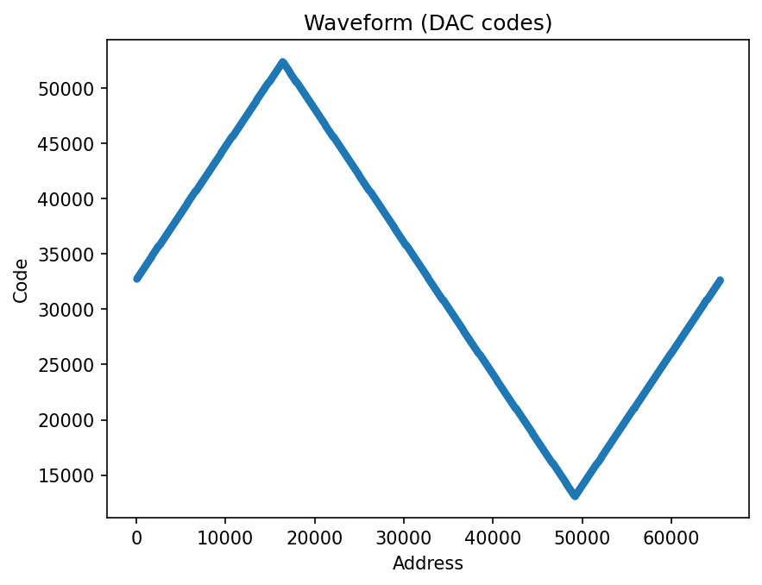
MCU Design Accomplishments

Slide 10
Remaining Tasks
Remaining in 403:
Clean up the SPI transmission
To complete in 404
Integration testing with other subsystems

Slide 11
FPGA Subsystem
Brayden Donovan
Design
Test
Validate
Store and retrieve data from MCU at variable speeds
Successfully Test JTAG programming, SPI configuration, and data storage
Verify data accuracy
Designed, ordered, and assembled custom FPGA PCB
Developed HDL code for FPGA
SPI Decoder
Binary Counter
NCO
SRAM controller logic
Developed test benches for all HDL modules
Developed C++ code for ESP32 to generate SPI test input
Used test benches to verify all HDL modules were working as intended in simulation
Was able to successfully program FPGA flash memory with JTAG
Used test SPI input to change operating mode of FPGA
LEDs turned on :)
Notes:
Overview of what has been designed, tested, and validated for each subsystem for the project. (this is NOT a progress update, but rather a summary of what you have accomplished in 403).

Slide 12
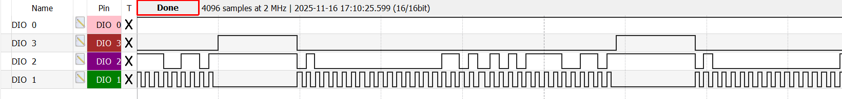
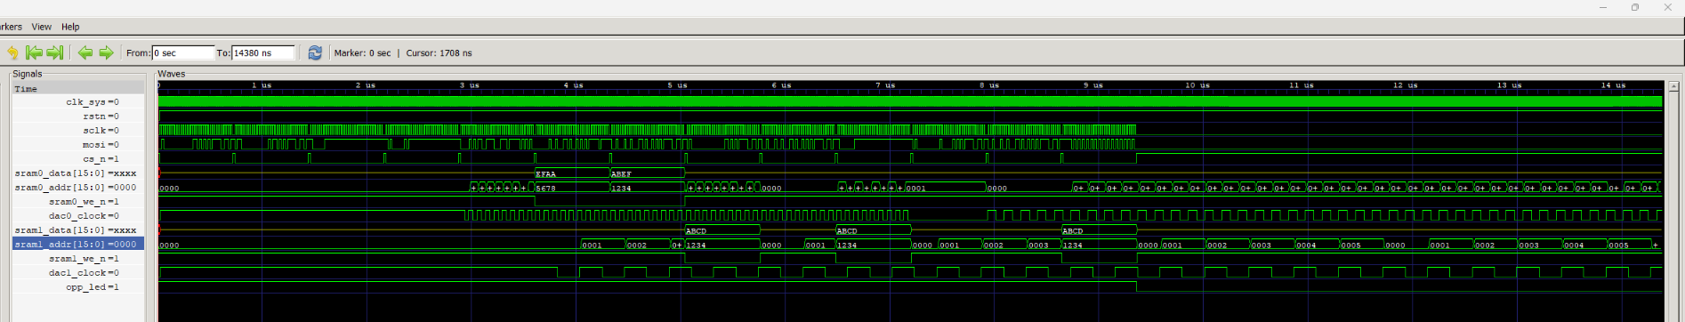
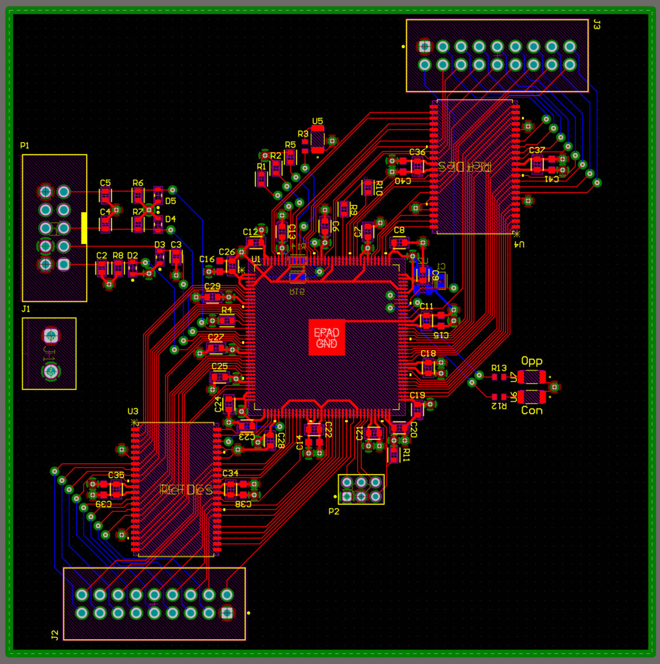
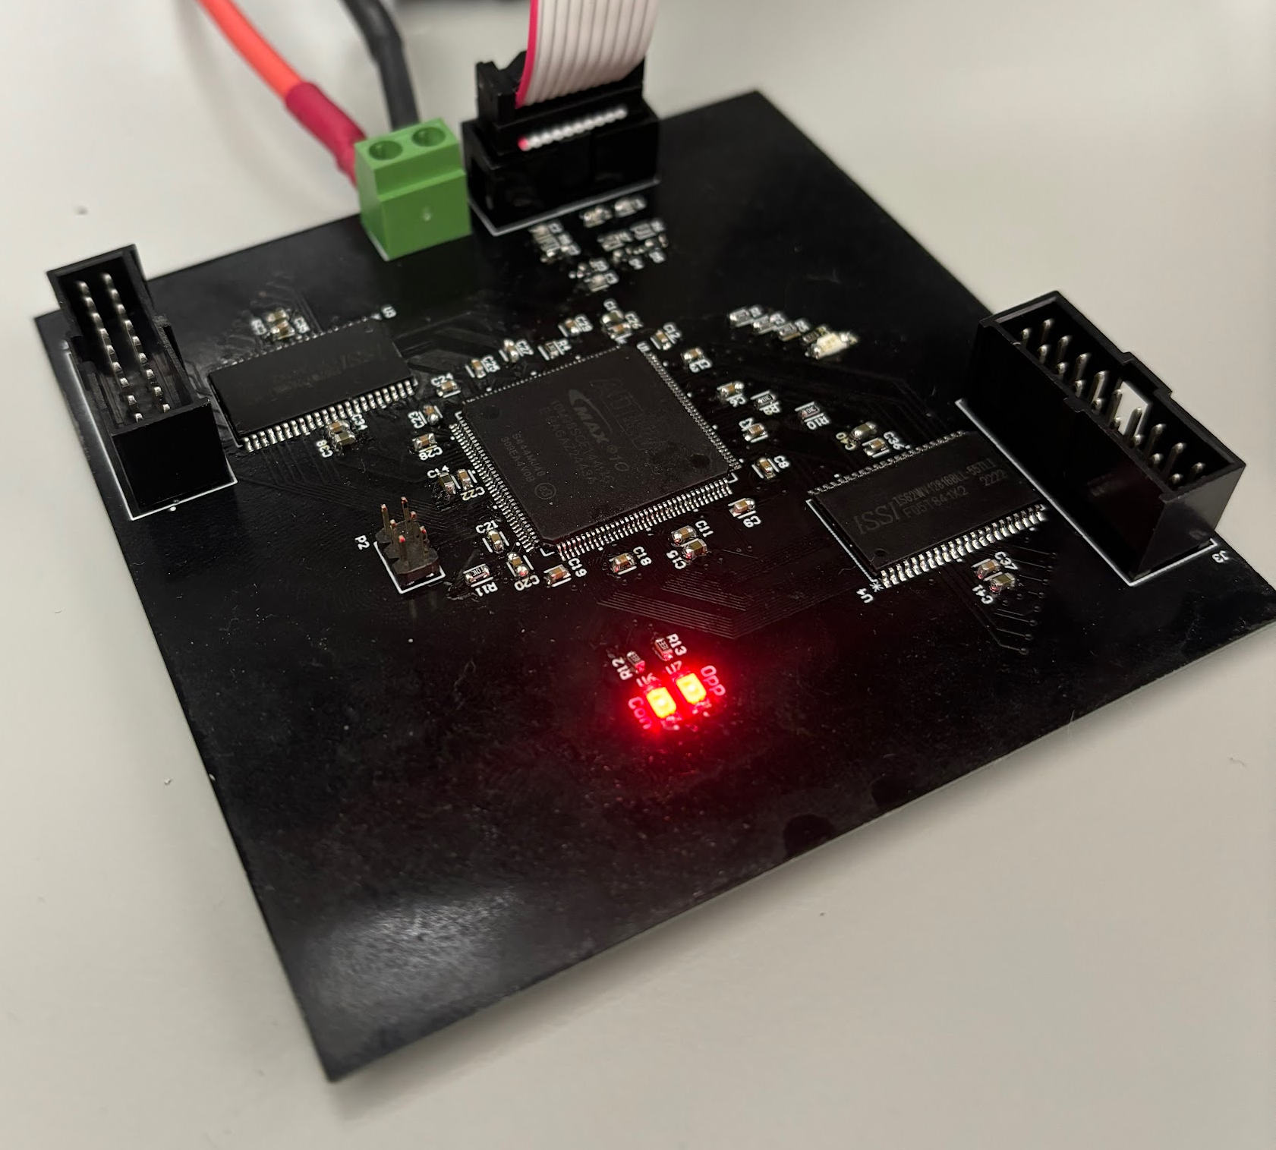
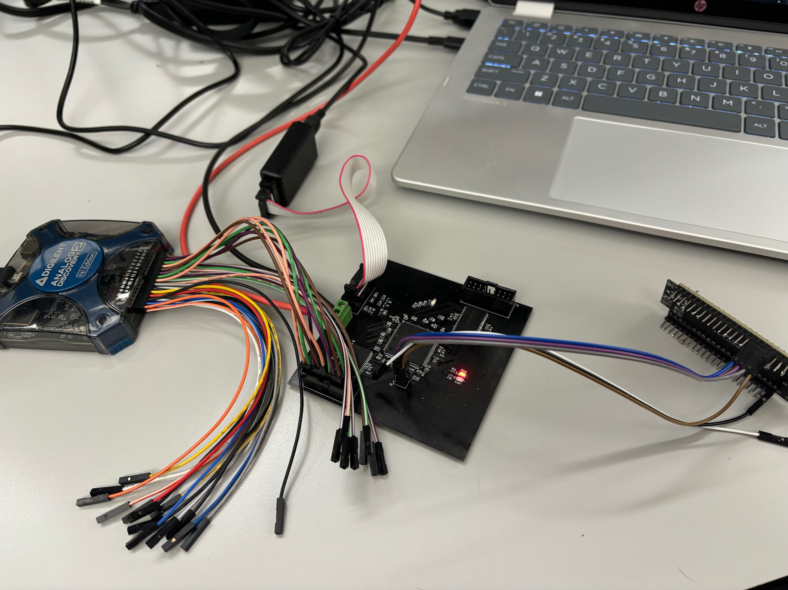

Slide 13
Remaining Tasks
Remaining in 403:
Debugging FPGA
Specifically the SPI decoder
To complete in 404
Integration testing with other subsystems

Slide 14
Power Subsystem
Salina Teng
Design
Test
Validate
Create a stable, low-noise multi-rail power design for the AWG
Verify converter startup behavior, rail stability, and load performance
Quantitatively confirm rail accuracy, noise, and reliability
Defined +12V → ±10V, +5V, +3.3V, and +3.3V_CLEAN rails with input protections and pi-filters
Created power design schematic
Selected regulators, capacitors, and precision voltage IC for low noise analog operation
Simulated transient/steady-state rail performance in LTspice
Measured rail voltage and startup behavior
Performed load-step and Vin-step tests on all rails
Confirmed rail accuracy and load regulation
Logged long-duration performance under max load
Notes:
Overview of what has been designed, tested, and validated for each subsystem for the project. (this is NOT a progress update, but rather a summary of what you have accomplished in 403).

Slide 15
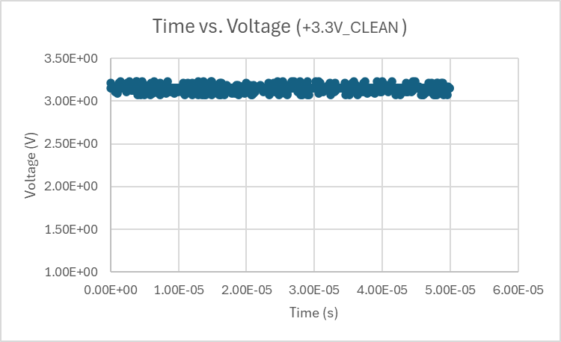
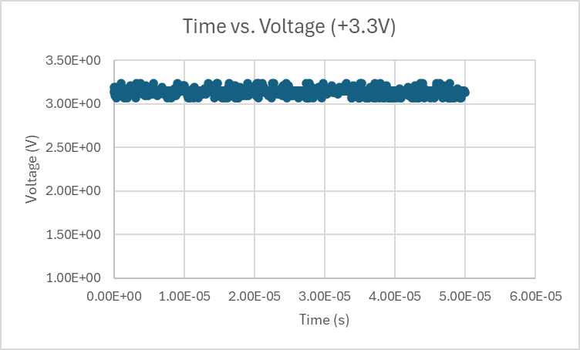
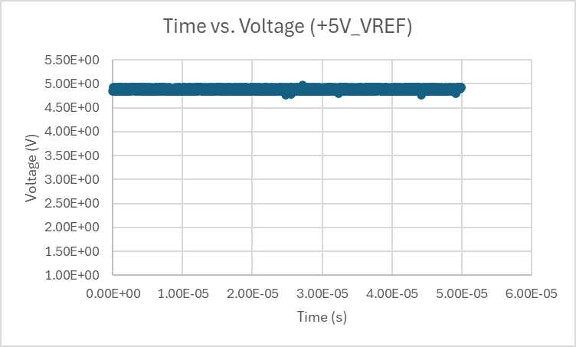
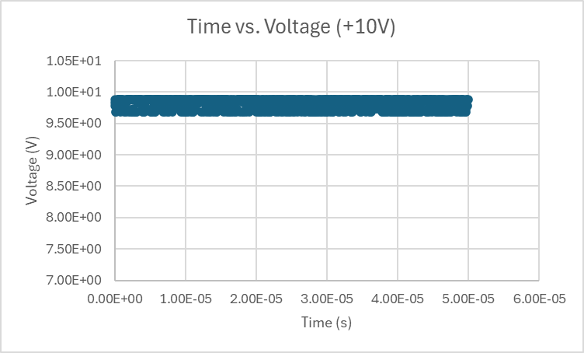
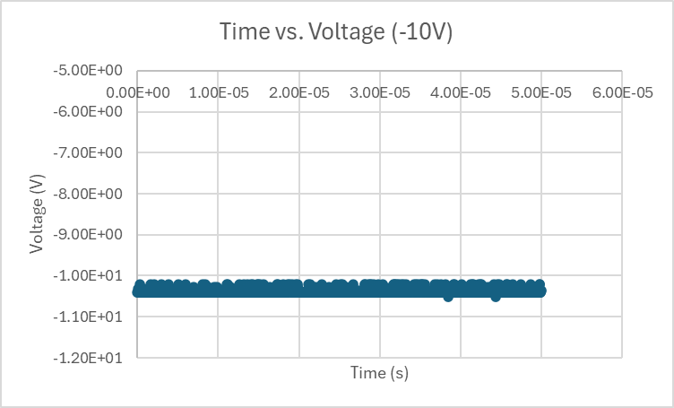
Power Design Accomplishments
Notes:
Show data collected and measured and/or simulated results (2 slides per subsystem)
Try to avoid screens of code
Save demo material for your project demo (video captures, storyboards, bench test pictures, etc.)

Slide 16
Remaining Tasks - Power
Verifying rails can run up to 30mins
Testing the rails under max load expected of each rail
ECEN 404 Key Design Activity
Verify that each rail can power the subsystems properly and stable, supplying enough current to each subsystem
Notes:
Summarize what remains to be completed for your subsystem design, assembly, test, and validation by Project Demo date.
Summarize what key design activity from each subsystem will be completed in 404 (eg. fabrication and assembly of final PCB, full ML model training, in-situ sensor calibration, enclosure design and fabrication, mount 3d-printing)

Slide 17
DAC/Output Filter Subsystem
Salina Teng
Design
Test
Validate
Design a reliable Power architecture for the AWG
Successfully Test BLE connection stability and packet transfer
Quantitatively verify successful tests
Established BLE Connection with MCU
Developed Front-End UI
Preset, Drawable, and Arbitrary adjustable screens with local waveform simulation
Included waveform editing, uploading, and downloading
Verified standard waveform parameters send to MCU accurately
Verified arbitrary waveform packets send to MCU accurately
Stress and Repeatability Testing ensured consistent results
App → MCU Communication connection strong and consistent within operational range
Ability to send numeric values, preset parameters, and Arbitrary waveform packages
Logging and Response confirmation from MSU
Notes:
Overview of what has been designed, tested, and validated for each subsystem for the project. (this is NOT a progress update, but rather a summary of what you have accomplished in 403).

Slide 18
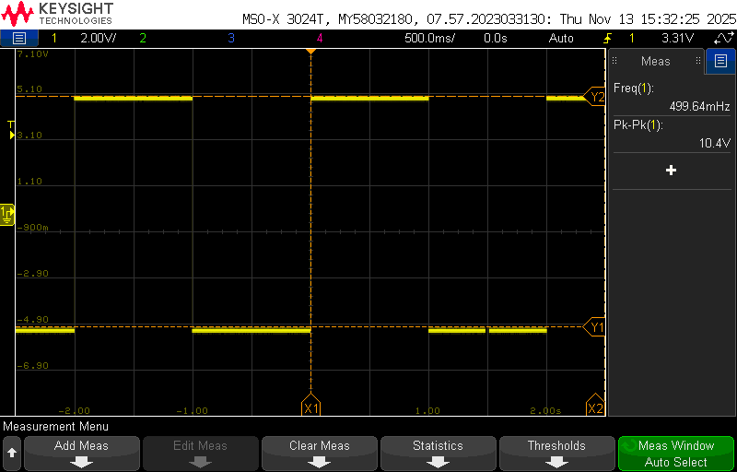
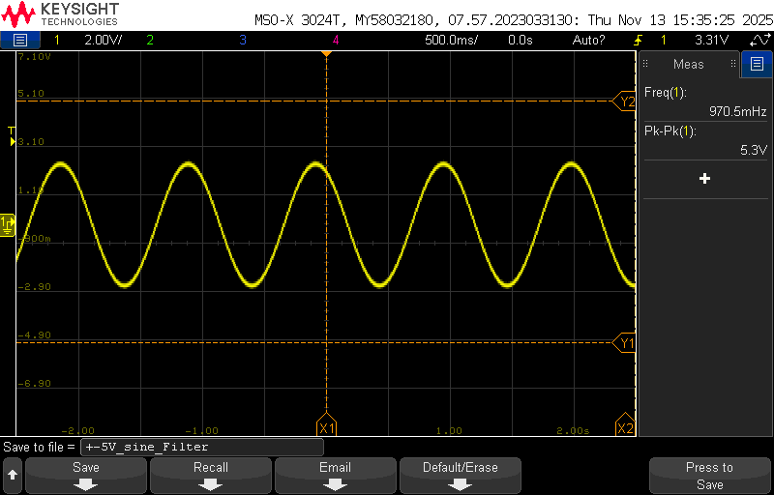
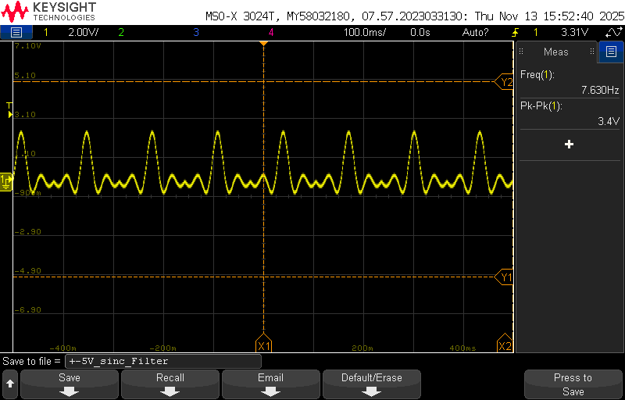
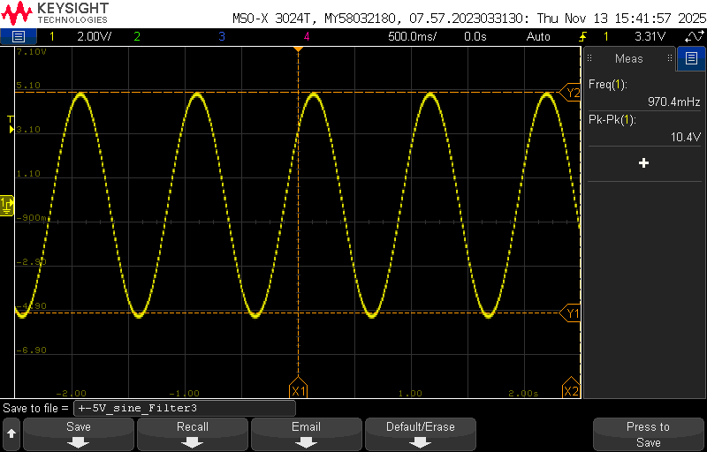
DAC/Output Filter Accomplishments
Pulsing DC/Square Wave: +-5V
Sine Wave:
+-2.5V
Sinc Wave:
1.7V
Sine Wave:
+-5V
Notes:
Show data collected and measured and/or simulated results (2 slides per subsystem)
Try to avoid screens of code
Save demo material for your project demo (video captures, storyboards, bench test pictures, etc.)

Slide 19
Remaining Tasks - Output Filters
Finish up on installing the second filter system on the DAC/Filter board
Testing the second filter system, making sure it can drive 50 Ohm impedance at max parameters (+-5V, 100kHz) for up to 30 mins
ECEN 404 Key Design Activity
Testing if the DAC/Filter board can take in FPGA 16-bit digital code and output the correct waveforms
Verifying system can produce multi frequency waveforms
Fully integrate with the FPGA subsystem
Notes:
Summarize what remains to be completed for your subsystem design, assembly, test, and validation by Project Demo date.
Summarize what key design activity from each subsystem will be completed in 404 (eg. fabrication and assembly of final PCB, full ML model training, in-situ sensor calibration, enclosure design and fabrication, mount 3d-printing)

Slide 20
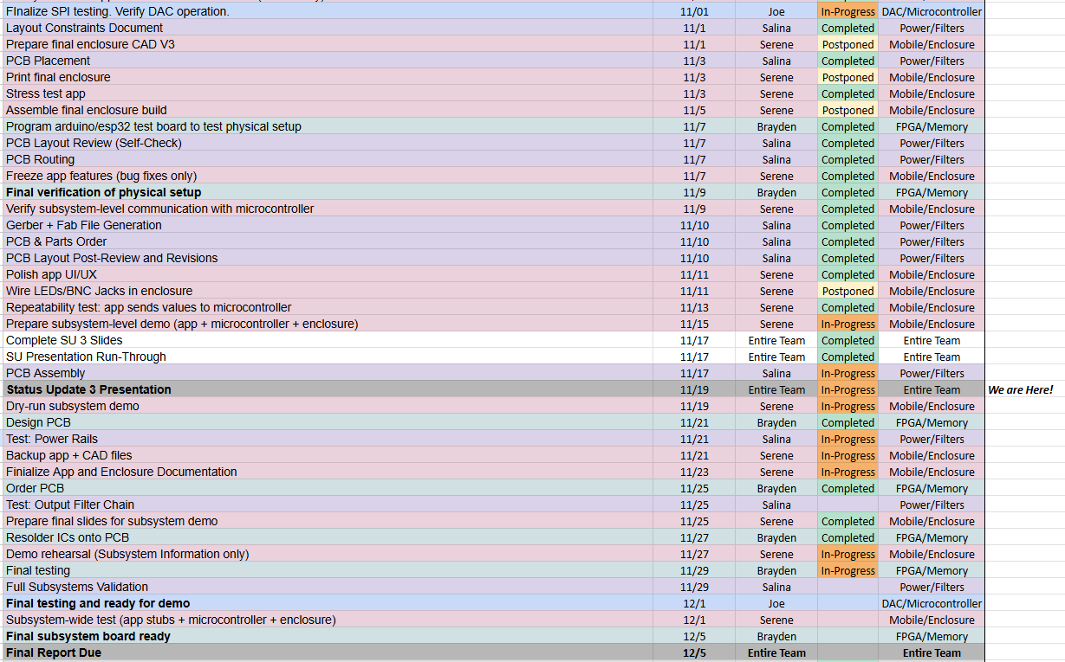
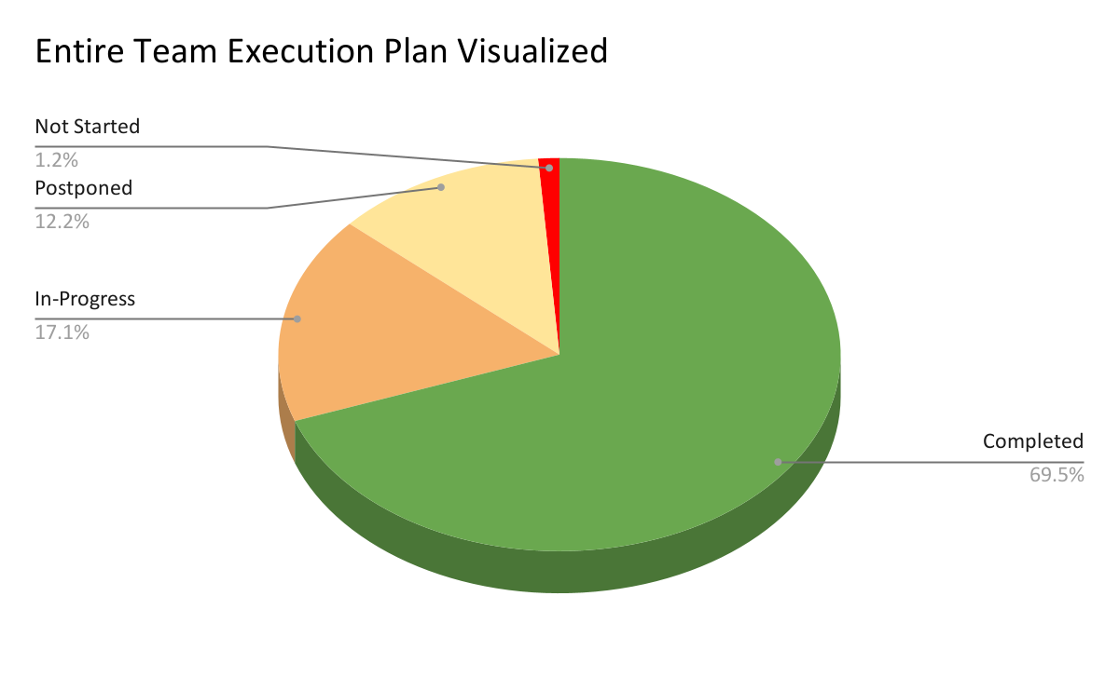
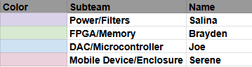
Team Execution Plan Status
Notes:
Execution and validation status against plan (2 slides) showing what has been accomplished. Make sure it is clear for plan which subsystems are associated with each milestone

Slide 21
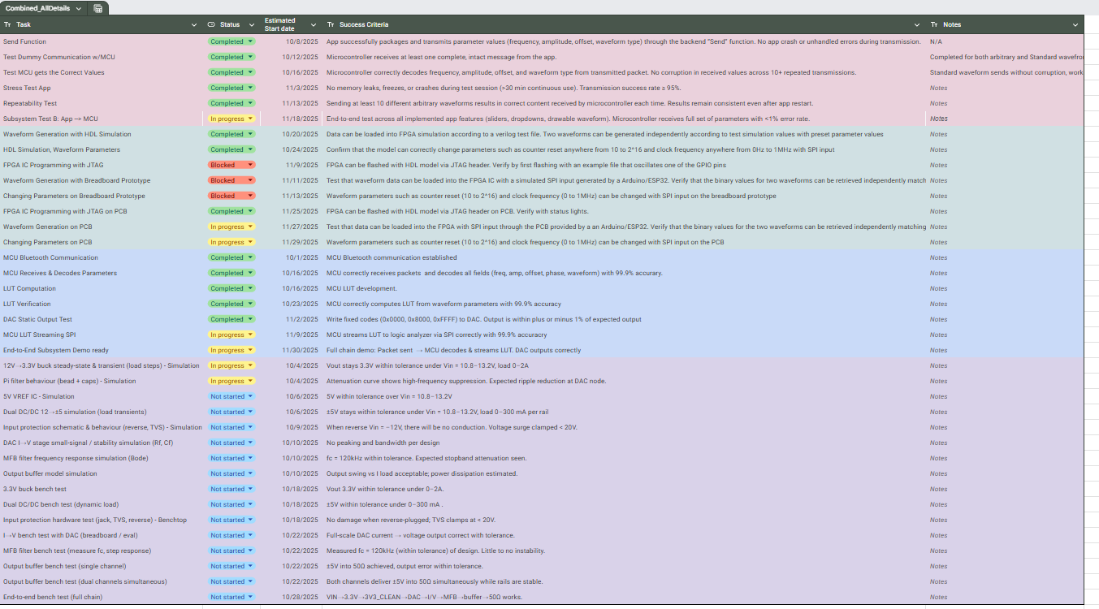
Team Validation Plan Status
Notes:
Execution and validation status against plan (2 slides) showing what has been accomplished. Make sure it is clear for plan which subsystems are associated with each milestone

